Slide 1
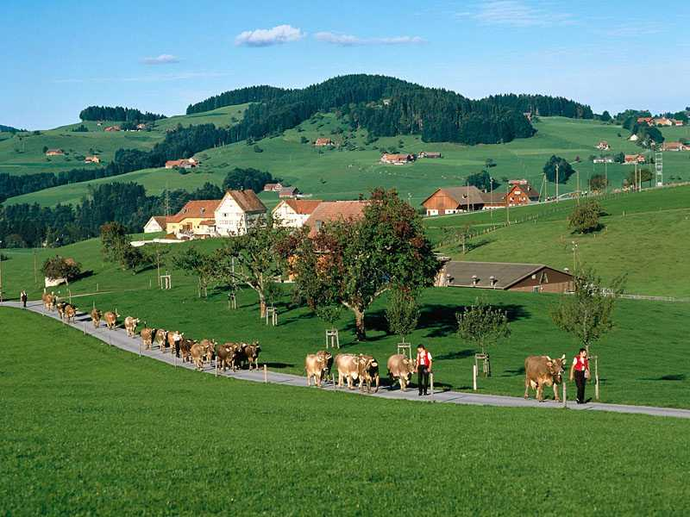
Appenzell, Switzerland

Slide 2
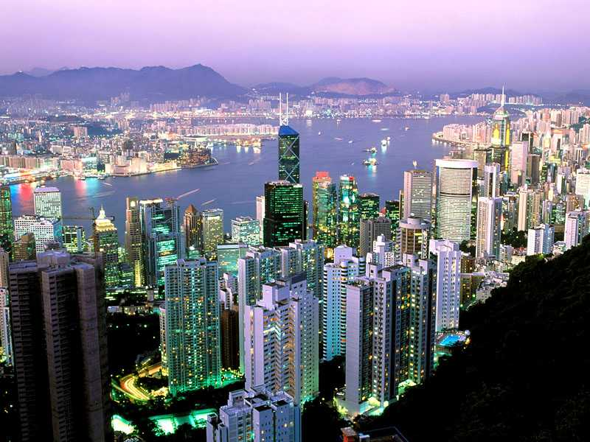
Citylights Shining at Dawn, Hong Kong, China

Slide 3
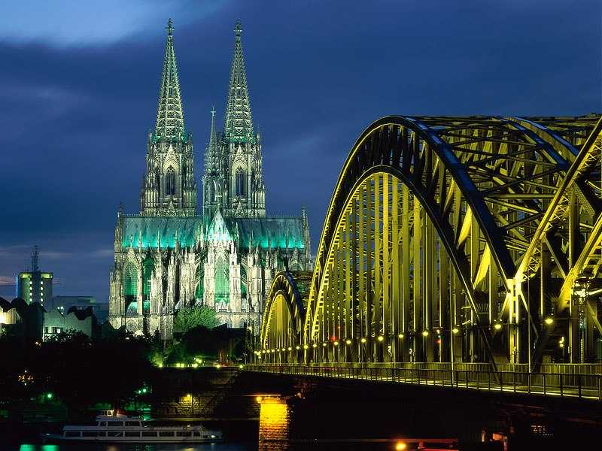
Cologne Cathedral and Hohenzollern Bridge, Cologne, Germany

Slide 4
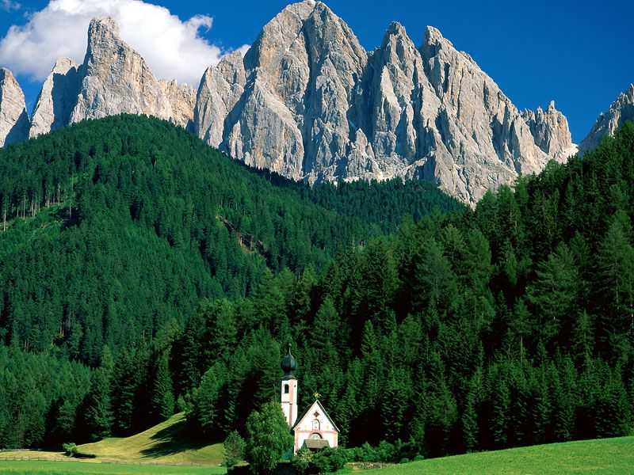
Dolomite Mountains, Italy

Slide 5
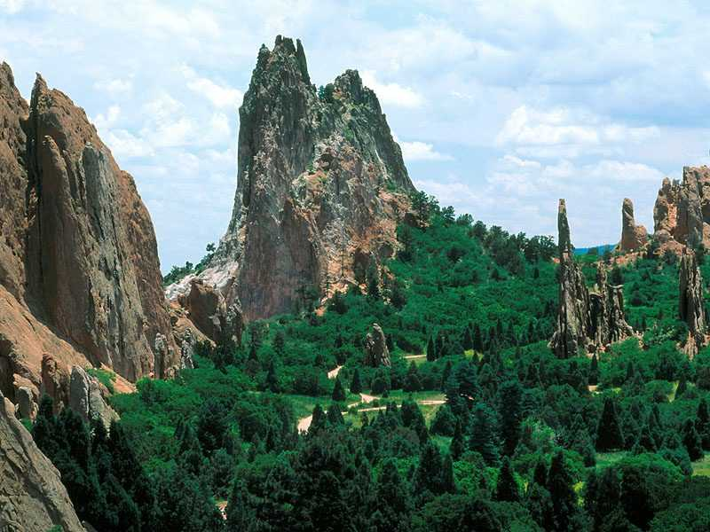
Garden of the Gods, Colorado Springs, Colorado

Slide 6
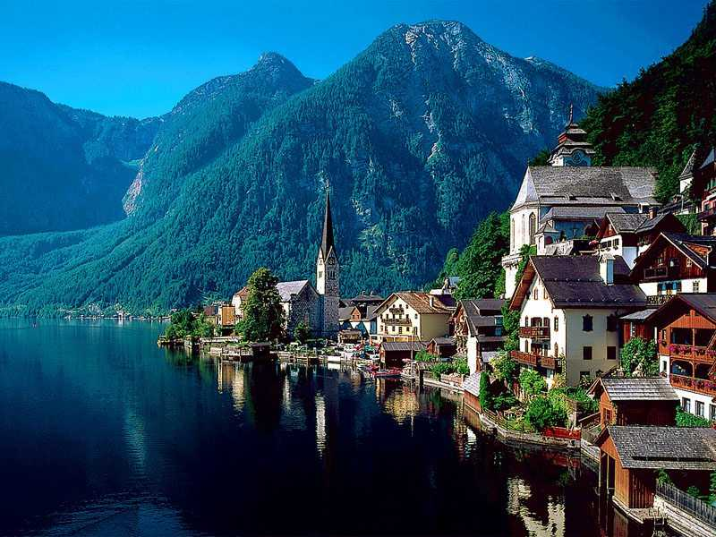
Hallstatt, Austria

Slide 7
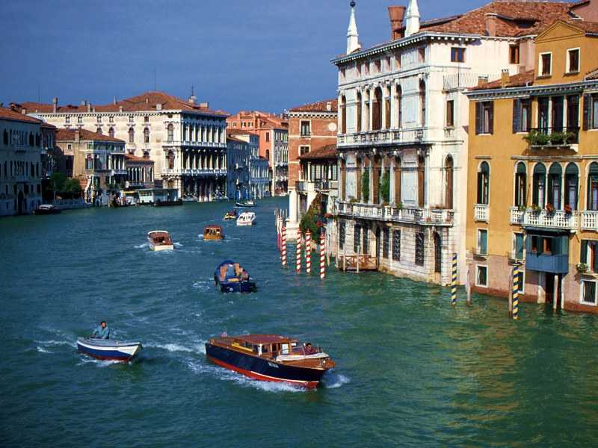
Rush Hour, Venice, Italy

Slide 8
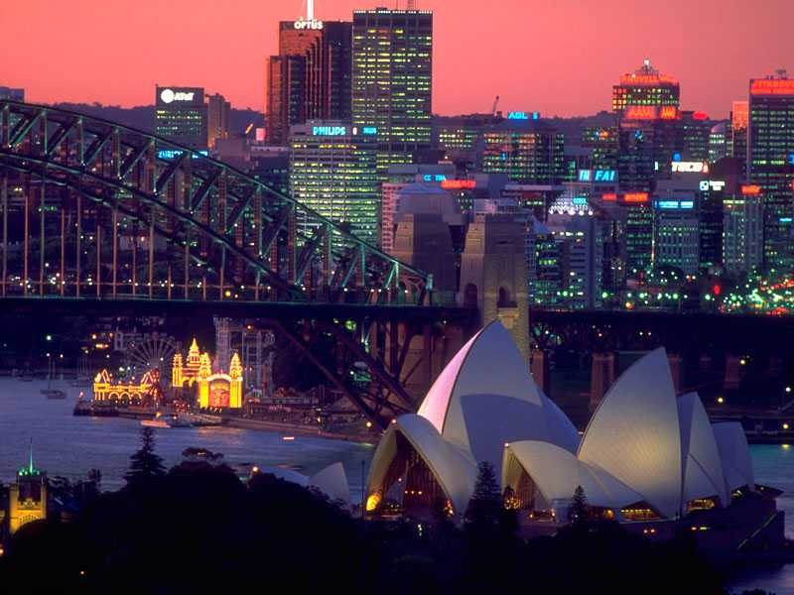
Skyline of Sydney, Australia

Slide 9
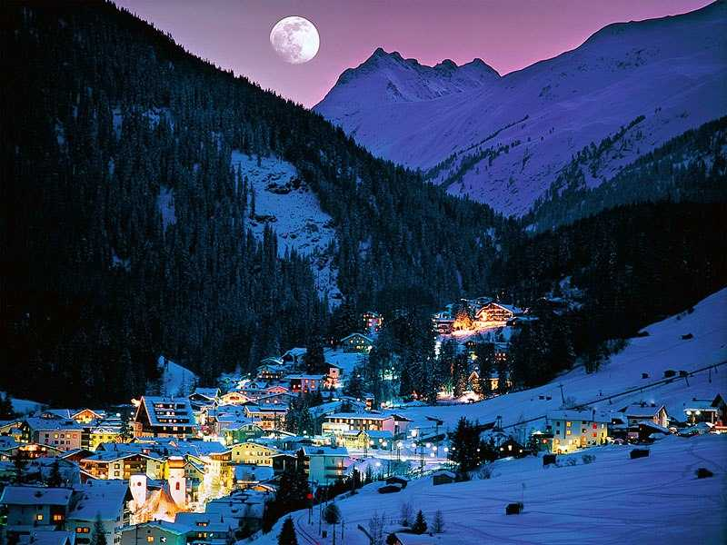
St. Anton at Arlberg, Tirol, Austria

Slide 10
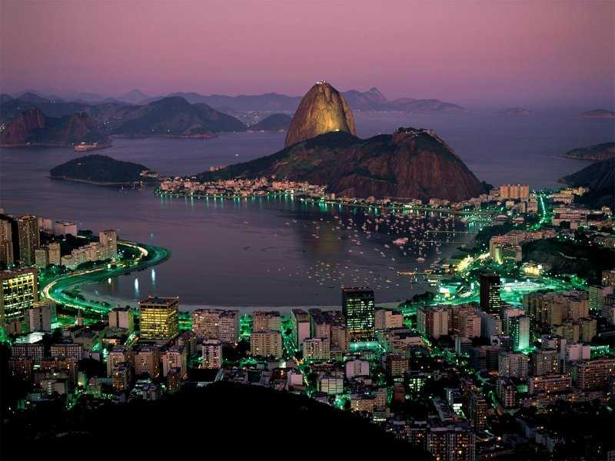
Sugar Loaf Mountain, Rio De Janeiro, Brazil

